Slide 1

Cryptography (Python)
Week1

Slide 2
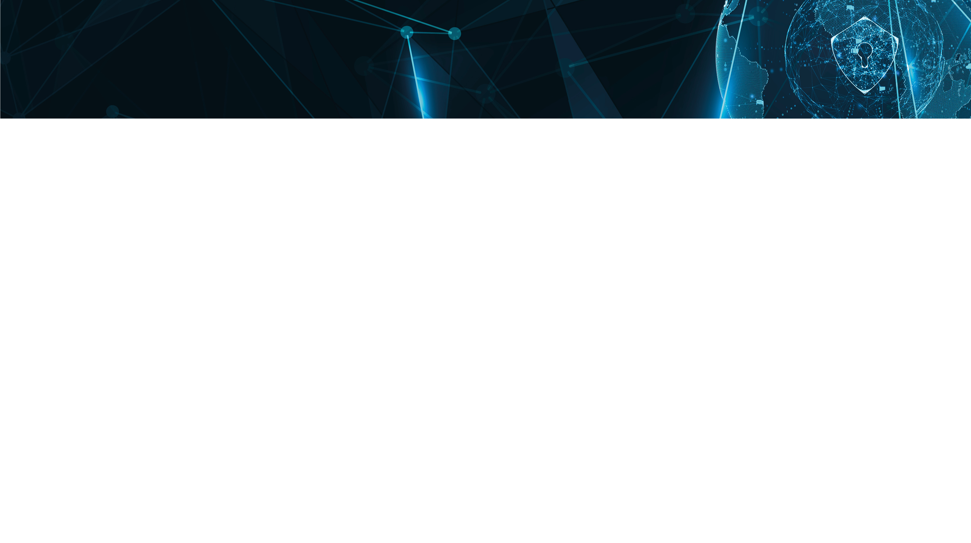
Cryptography (Python)
You will be learning about
Programming in Cryptography
UNITEC CYBERSECURITY LAUNCH EVENT | DATE

Slide 3
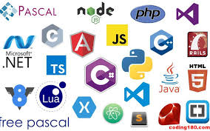
Programming Language
UNITEC CYBERSECURITY LAUNCH EVENT | DATE

Slide 4
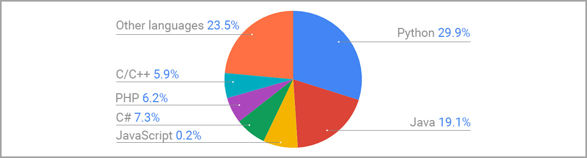
Trendiest Programming Language of 2020 (www.scand.com)
UNITEC CYBERSECURITY LAUNCH EVENT | DATE

Slide 5
Cryptography and Programming
What is the best programming languages for Cryptography?
Python: next slide
Golang: settled by Google, and till today, numerous programmers who use it for the execution of cryptography
Ruby: is really predicted toward being the descendant to Python
C/C++: the myth of C/C++ is a programming language that could be said, the “authorized” programming language of cryptography
Java: is a language that reasons divide in the software improvement world.
Read more at: https://www.freelancinggig.com/blog/2017/08/04/best-programming-languages-cryptography/
UNITEC CYBERSECURITY LAUNCH EVENT | DATE

Slide 6
Why Python?
The syntax is simple and easy to learn
Versatility (Data science, Cryptography, Machine Learning, Game Development, Web Development and etc.)
Value and demand (Facebook, Google, NASA, Amazon, Instagram, Netflix, and etc.)
“Python is still a preferred for the execution of cryptography, in specific for analysis.”
UNITEC CYBERSECURITY LAUNCH EVENT | DATE

Slide 7
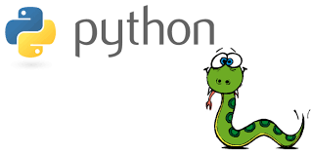
What is Python?
Before 1980s, Python was just snake!
UNITEC CYBERSECURITY LAUNCH EVENT | DATE

Slide 8
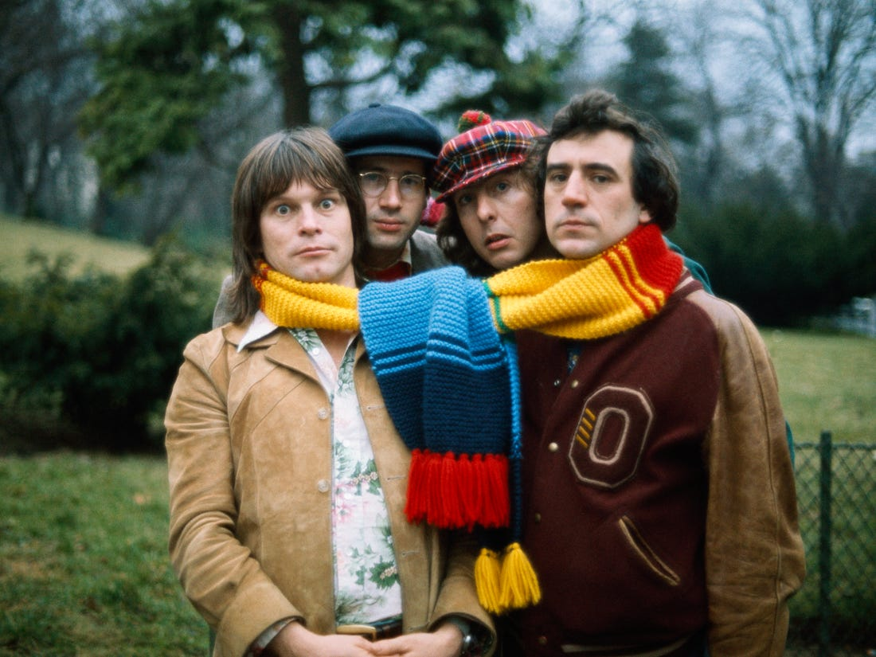
What is Python?
From 1969 to 1974, Monty Python was a British comedy series created by the comedy group Monty Python and broadcast by the BBC.
UNITEC CYBERSECURITY LAUNCH EVENT | DATE

Slide 9
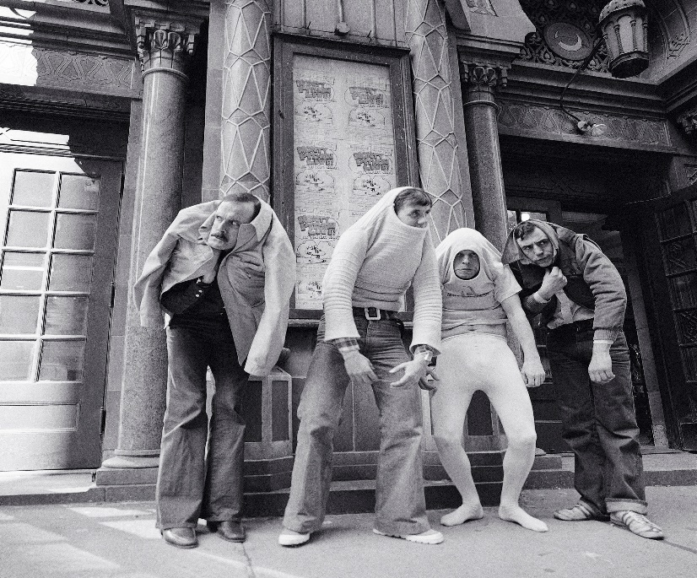
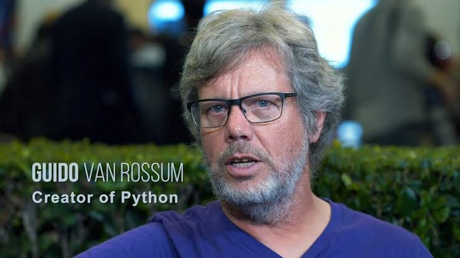
What is Python?
“Over six years ago, in December 1989, I was looking for a "hobby" programming project that would keep me occupied during the week around Christmas. My office would be closed, but I had a home computer, and not much else on my hands. I decided to write an interpreter for the new scripting language I had been thinking about lately: a descendant of ABC that would appeal to Unix/ C hackers. I chose Python as a working title for the project, being in a slightly irreverent mood (and a big fan of Monty Python Flying Circus)”
UNITEC CYBERSECURITY LAUNCH EVENT | DATE

Slide 10
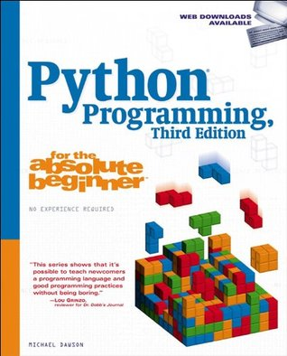
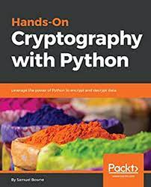
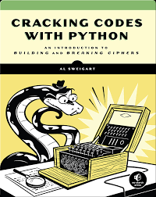
Books
Python Programming for the Absolute Beginner By Michael Dawson
Hands-On Cryptography with Python: Leverage the Power of Python to Encrypt and Decrypt Data by Samuel Bowne
Cracking Codes with Python: An Introduction to Building and Breaking Ciphersby by Al Sweigart
UNITEC CYBERSECURITY LAUNCH EVENT | DATE

Slide 11
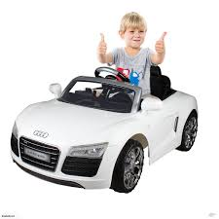
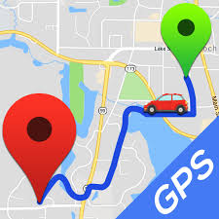
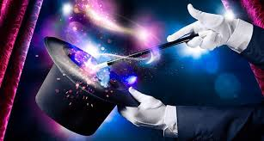
Let’s start!
Let’s start driving; What do you need?
Driving skills
UNITEC CYBERSECURITY LAUNCH EVENT | DATE

Slide 12
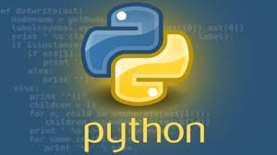

Let’s start!
Let’s start writing a programme!
A programme language
An algorithm
You still need some Magic
Programming Skills
UNITEC CYBERSECURITY LAUNCH EVENT | DATE

Slide 13

What is the Programming?
Programming is the process of taking an Algorithm and encoding it into a notation, so that it can be executed by a computer.
UNITEC CYBERSECURITY LAUNCH EVENT | DATE

Slide 14

What is an Algorithm?
An algorithm is a process or set of rules to be followed in calculations or other problem-solving operations, especially by a computer.
UNITEC CYBERSECURITY LAUNCH EVENT | DATE

Slide 15
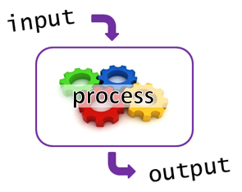
What does a Program?
A program takes inputs, processes the inputs and creates outputs.
Storage
Programming is a learned skill; you should spend more TIME!
UNITEC CYBERSECURITY LAUNCH EVENT | DATE

Slide 16
Outline
Types of Variables
Types of Statements
Mathematical Operations
UNITEC CYBERSECURITY LAUNCH EVENT | DATE

Slide 17
Life of a Programmer
What do you do most of the time?
As a programmer, you will:
Design a program solutions
Code those solutions
Get numerous errors
Fix errors
Test your codes
Get errors again
And………
UNITEC CYBERSECURITY LAUNCH EVENT | DATE

Slide 18
Types of Variables
Integers: whole numbers with no decimal point
Examples: 100, 25, 1000000, 0
Floating Points: the decimal point floats around
Examples: 2.16, 58.000001, 40.4
Strings: collection of characters
Examples: “Soheil”, “Sam123”, “20.54”, “10”
UNITEC CYBERSECURITY LAUNCH EVENT | DATE

Slide 19
Converting Variable Types
Float to Integer:
int(x) changing x to an integer variable
int(24.65) = ?
int(“abc”) = ?
Integer to Float:
float(x) changing x to an float variable
float(24) = ?
UNITEC CYBERSECURITY LAUNCH EVENT | DATE

Slide 20
Converting Variable Types
String to different variable types:
str(x) changing x to an string variable
str(24.65) = ?
str(“abc”) = ?
str(abc) = ?
str(‘a’+’b’) = ?
UNITEC CYBERSECURITY LAUNCH EVENT | DATE

Slide 21
Mathematical Operations
Addition (+)
Subtraction (-)
Examples:
‘a’ - ’b’ = ?
“a” + “b” = ?
4 + 5 = ?
UNITEC CYBERSECURITY LAUNCH EVENT | DATE

Slide 22
Mathematical Operations
Multiplication ( * )
Division ( / )
Examples:
2 * 2 = ?
‘a’ * ‘b’= ?
2 * ‘a’ = ?
2 / 2 = ?
UNITEC CYBERSECURITY LAUNCH EVENT | DATE

Slide 23
Mathematical Operations
Division Integer ( // )
Modulus ( % )
Power ( ** )
Examples:
5 // 3 = ?
5 % 3 = ?
2 ** 4 = ?
UNITEC CYBERSECURITY LAUNCH EVENT | DATE

Slide 24
Types of Statements
Three types of statements:
Input statements
Processing statements
Output statements
UNITEC CYBERSECURITY LAUNCH EVENT | DATE

Slide 25
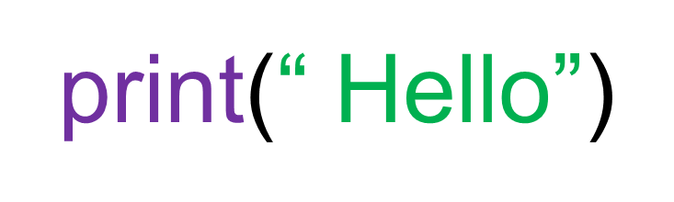
Output Statement
print statement should be in lower case
Open parentheses and close it
Message should be inside quote “ ”
Check colour; purple for print and green for message and quote
UNITEC CYBERSECURITY LAUNCH EVENT | DATE

Slide 26
Input Statements
Input statements:
Examples:
print('what is your name?')
Name = input()
or
Name = input (‘what is you name?’)
Type of variable (Name)? (int, str, or float ?)
Can we change the variable name?
UNITEC CYBERSECURITY LAUNCH EVENT | DATE

Slide 27
Input Statements
Input statements:
Examples:
Salary = input (‘what is you salary?’)
Or
b) Salary = float(input(‘what is your salary?’))
a or b?
What is a type of variable (Salary) in a?
What is a type of variable (Salary) in b?
UNITEC CYBERSECURITY LAUNCH EVENT | DATE

Slide 28
Processing Statements
Processing statements:
Examples:
a)
Age = input(‘when is your birthday?’)
Birthday = 2020 – Age
print (Birthday)
Or
b)
Age = int(input(‘when is your birthday?’))
Birthday = 2020 – Age
print(Birthday)
a or b?
UNITEC CYBERSECURITY LAUNCH EVENT | DATE

Slide 29
Worksheets 1&2
Please find the worksheets 1&2 on Moodle
UNITEC CYBERSECURITY LAUNCH EVENT | DATE

Slide 30
Any Question?
UNITEC CYBERSECURITY LAUNCH EVENT | DATE

